Slide 1

Business Intelligence
Nishika Jayasinghe

Slide 2
Week 2_Day_1_Big data
Welcome
Topic 1 discussion_What is Big data?
Activity based on the teaching
Assessment 1 discussion
Activity to find data, business intelligence tools and techniques for the assessment

Slide 3
Activity based on the teaching
Choose one topic from the list in slide no 19
Open the related link.
You need to read the information on the web page
Discuss how Big data applies in today’s world.
Do it individually and discuss within your group
Your final outcomes should be available on the whiteboard - as a group

Slide 4
Assessment 1_discussion
Identify three business requirements
To identify three business requirements students, need to do small research around the chosen business and they could find case studies of the business if not they can find similar business cases in the other businesses in the industry as well
You can incorporate what you have learned from the previous activity
Identify data need for each business problem, link different BI tools and techniques to address the business requirements

Slide 5
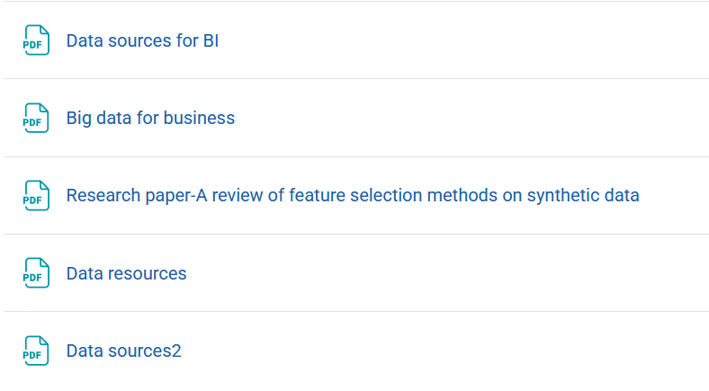
Homework
Read the articles in module 2 and summaries them by week 3 Tuesday. These articles help and guide you to complete the assessment 1- See the below screenshot to know what articles you need to read in the Moodle

